Slide 1




Tree Diagrams
Tree Diagrams: We can solve many counting problems through the use of tree diagrams, where a branch represents a possible choice and the leaves represent possible outcomes.
Example: Suppose that “I Love Discrete Math” T-shirts come in five different sizes: S,M,L,XL, and XXL. Each size comes in four colors (white, red, green, and black), except XL, which comes only in red, green, and black, and XXL, which comes only in green and black. What is the minimum number of shirts that the campus book store needs to stock to have one of each size and color available?

Slide 2

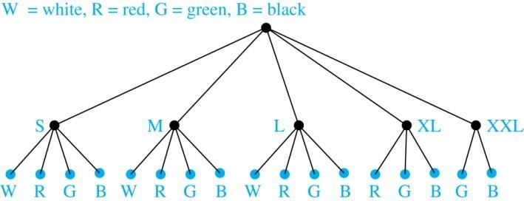
Tree Diagrams
Solution: Draw the tree diagram.
The store must stock 17 T-shirts.

Slide 3


Section 6.2

Slide 4

Section Summary
The Pigeonhole Principle
The Generalized Pigeonhole Principle

Slide 5

The Pigeonhole Principle
Pigeonhole Principle: If k is a positive integer and k + 1 objects are placed into k boxes, then at least one box contains two or more objects.
Proof: We use a proof by contraposition. Suppose none of the k boxes has more than one object. Then the total number of objects would be at most k. This contradicts the statement that we have k + 1 objects.

Slide 6
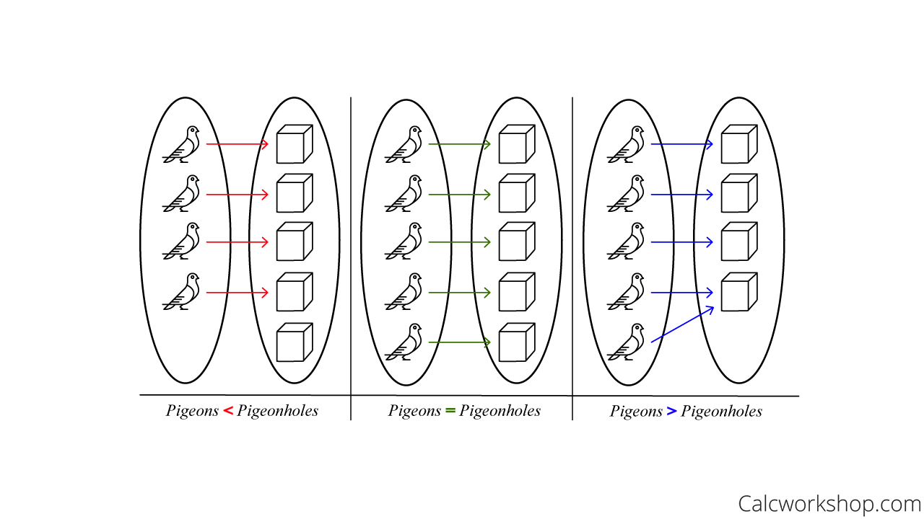

Slide 7

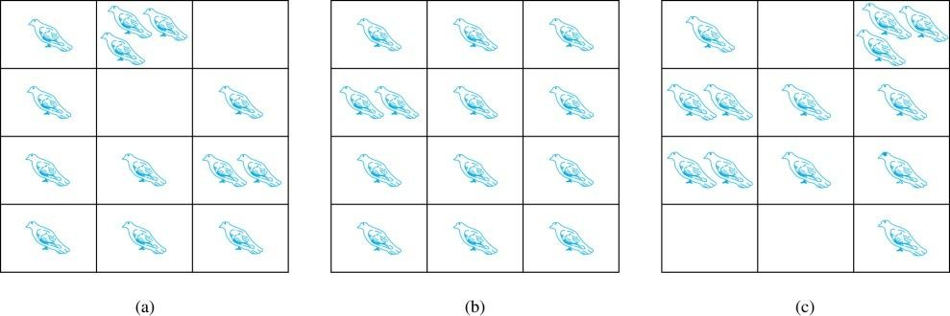

The Pigeonhole Principle
If a flock of 20 pigeons roosts in a set of 19 pigeonholes, one of the pigeonholes must have more than 1 pigeon.

Slide 8

The Pigeonhole Principle
Corollary 1: A function f from a set with k + 1
elements to a set with k elements is not one-to-one.
Proof: Use the pigeonhole principle.
Create a box for each element y in the codomain of f .
Put in the box for y all of the elements x from the
domain such that f(x) = y.
Because there are k + 1 elements and only k boxes, at least one box has two or more elements.
Hence, f can’t be one-to-one.

Slide 9

Pigeonhole Principle
Example: Among any group of 367 people, there must be at least two with the same birthday, because there are only 366 possible birthdays. ⌈367/366⌉ = 2
Example: Among 100 people there are at least
⌈100/12⌉ = 9 who were born in the same month.
Example: In any set of 27 English , must be at least two that begin with the same letter, since there are 26 letters in the English alphabet. ⌈27/26⌉ = 2

Slide 10

The Generalized Pigeonhole Principle
Example: What is the minimum number of students required in a Discrete Mathematics class to be sure that at least six will receive the same grade, if there are five possible grades, A, B, C, D, and F.
Solution:
The minimum number of students needed to guarantee that at least six students receive the same grade is the smallest integer N such that ⌈ N/K ⌉ = ⌈ N/5 ⌉ = 6. The smallest such integer is
N = K(⌈ N/K ⌉-1)+1 = 5(6-1)+1=5 ⋅ 5 + 1 = 26.
Thus 26 is the minimum number of students needed to be sure that at least 6 students will receive the same grades.

Slide 11
A bowl contains 10 red balls and 10 blue balls. A woman selects balls at random without looking at them. (a) How many balls must she select (minimum) to be sure of having at least three blue balls? (b) How many balls must she select (minimum) to be sure of having at least three balls of the same color?
a. The answer is 13.
As the women selects the balls at random without looking at them, there is a possibility that the first 10 balls which she selects are all red. Then to have atleast 3 blue balls she has to pick three balls from the rest of 10 balls. As all of them are blue only 3 picks are needed for that. Hence 10+3=13 balls she need to pick to be sure of having atleast 3 blue balls.

Slide 12
b. The answer is 5.
As there are 2 colours of balls present in the bowl, Red and Blue. Consider there is a Red bucket and a Blue bucket outside the bowl and after picking each ball from the bowl, each ball must go to either of the buckets. Hence applying pigeonhole principle to be sure of having atleast 3 balls of same colour
she need to pick 2+2+1=5 balls from the bowl.

Slide 13
A bowl contains 10 red balls, 10 blue balls and 10 black balls. A woman selects balls at random without looking at them:
a) How many balls must she select to be sure of having at least three balls of the same color?
b) How many balls must she select to be sure of having at least three blue balls?
a) 2+2+2+1
b) 23, because if she select 10 red balls and 10 black balls, than she must select those 3 blue balls to be sure that they are at least three of them blue..

Slide 14
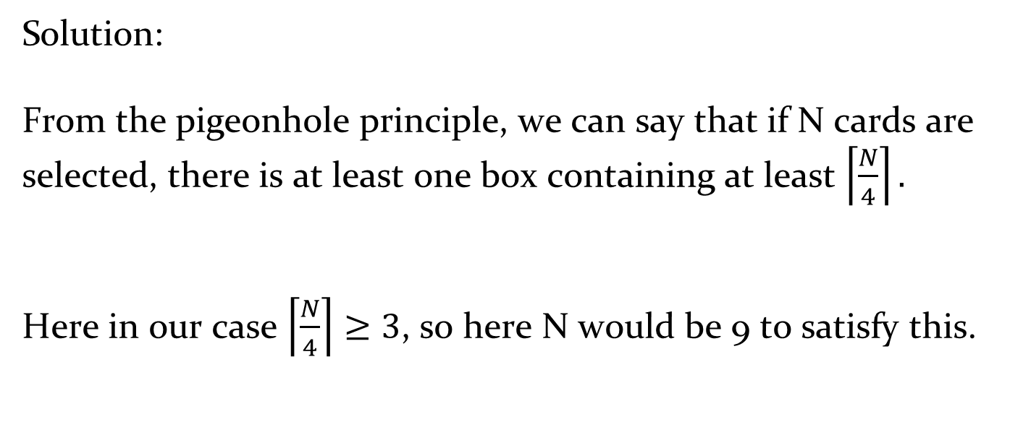
How many cards must be selected from an standard deck of 52 cards guarantee three cards of the same suit are selected
Solution:
From the pigeonhole principle, we can say that if N cards are selected, there is at least one box containing at least $\left\lceil \frac{N}{4}\right\rceil .$
Here in our case $\left\lceil \frac{N}{4}\right\rceil ≥3$, so here N would be 9 to satisfy this.

Slide 15
How many cards must be picked to make sure that there are atleast 3 hearts.
Solution:
13+13+13+3 = 42

Slide 16

Section 6.3

Slide 17

Section Summary
Permutations
Combinations
Combinatorial Proofs

Slide 18
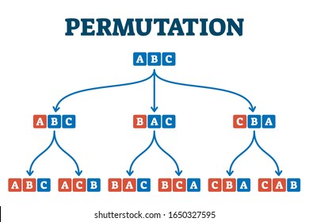

Slide 19
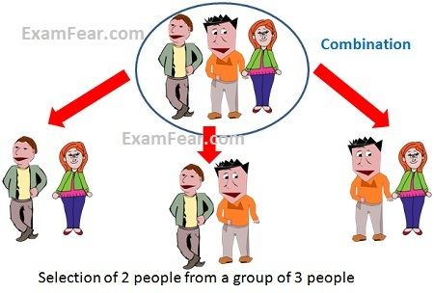

Slide 20

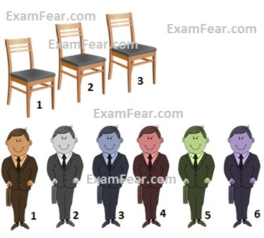

Slide 21
Difference between Permutation and Combinations
Example: for combinations {a,b} and {b,a} is same
C(4,2) = 6 because the 2-combinations of {a, b, c, d} are the six subsets {a, b}, {a, c}, {a, d}, {b, c}, {b, d}, and {c, d}.
For permutations {a,b} and {b,a} are not same
P(4,2) = 12 because the 2-permutations of {a,b,c,d} are 12 subsets {a,b},{a,c},{a,d}, {b,a},{b,c},{b,d},{c,a}, {c,b}, {c,d},{d,a},{d,b}, {d,c}

Slide 22
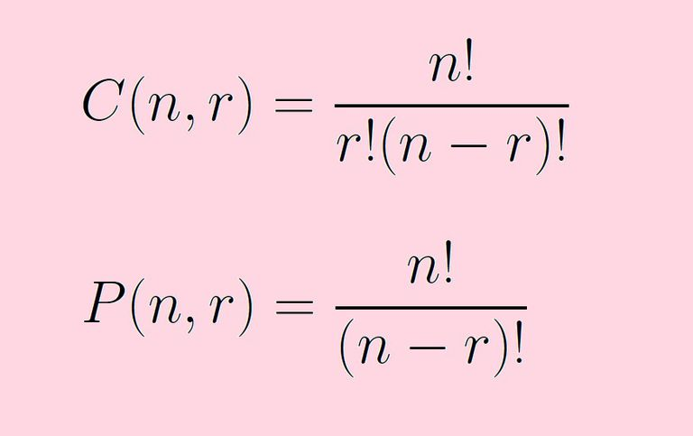

Slide 23

Permutations
Definition: A permutation of a set of distinct objects is an ordered arrangement of these objects. An ordered arrangement of r elements of a set is called an r-permutation.
Example: Let S = {1,2,3}.
The ordered arrangement 3,1,2 is a permutation of S.
The ordered arrangement 3,2 is a 2-permutation of S.
The number of r-permutations of a set with n
elements is denoted by P(n,r).
The 2-permutations of S = {1,2,3} are 1,2; 1,3; 2,1; 2,3;
3,1; and 3,2. Hence, P(3,2) = 6.

Slide 24

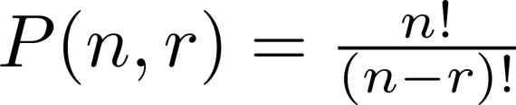
A Formula for the Number of Permutations
Theorem 1: If n is a positive integer and r is an integer with
1 ≤ r ≤ n, then there are
P(n, r) = n(n − 1)(n − 2) ∙∙∙ (n − r + 1)
r-permutations of a set with n distinct elements.
Proof: Use the product rule. The first element can be chosen in n
ways. The second in n − 1 ways, and so on until there are
(n − ( r − 1)) ways to choose the last element.
Note that P(n,0) = 1, since there is only one way to order zero elements.
Corollary 1: If n and r are integers with 1 ≤ r ≤ n, then

Slide 25

Solving Counting Problems by Counting Permutations
Example: How many ways are there to select a first- prize winner, a second prize winner, and a third-prize winner from 100 different people who have entered a contest?
Solution:
P(100,3) = 100 ∙ 99 ∙ 98 = 970,200

Slide 26

Solving Counting Problems by Counting Permutations (continued)
Example: Suppose that there are eight runners in a race. The winner receives a gold medal, the second place finisher receives a silver medal, and the third-place finisher receives a bronze medal. How many different ways are there to award these medals, if all possible outcomes of the race can occur and there are no ties?
Solution: The number of different ways to award the medals is the number of 3-permutations of a set with eight elements. Hence, there are
P(8, 3) = 8 · 7 · 6 = 336
possible ways to award the medals.

Slide 27

Solving Counting Problems by Counting Permutations (continued)
Example: Suppose that a saleswoman has to visit eight different cities. She must begin her trip in a specified city, but she can visit the other seven cities in any order she wishes. How many possible orders can the saleswoman use when visiting these cities?
Solution: The first city is chosen, and the rest are ordered arbitrarily. Hence the orders are:
P(7,7)= 7! = 7 ∙ 6 ∙ 5 ∙ 4 ∙ 3 ∙ 2 ∙ 1 = 5040
If she wants to find the tour with the shortest path that visits all the cities, she must consider 5040 paths!

Slide 28

Solving Counting Problems by Counting Permutations (continued)
Example: How many permutations of the letters
ABCDEFGH contain the string ABC ?
Solution: We solve this problem by counting the permutations of six objects, ABC, D, E, F, G, and H.
P(6,6)= 6! = 6 ∙ 5 ∙ 4 ∙ 3 ∙ 2 ∙ 1 = 720

Slide 29


Combinations
Definition: An r-combination of elements of a set is an unordered selection of r elements from the set.
Thus, an r-combination is simply a subset of the set with r elements.
The number of r-combinations of a set with n distinct elements is denoted by C(n, r).
The notation is also used and is called a binomial coefficient. (We will see the notation again in the binomial theorem in Section. 6.4)

Slide 30

Combinations
Example:
Let S be the set {a, b, c, d}. Then {a, c, d} is a 3- combination from S. It is the same as {d, c, a} since the order listed does not matter.
C(4,2) = 6 because the 2-combinations of {a, b, c, d} are the six subsets {a, b}, {a, c}, {a, d}, {b, c}, {b, d}, and {c, d}.
P(4,2) = 12 because the 2-permutations of {a,b,c,d} are 12 subsets {a,b},{a,c},{a,d}, {b,a},{b,c},{b,d},{c,a}, {c,b}, {c,d},{d,a},{d,b}, {d,c}

Slide 31


Combinations
Theorem 2: The number of r-combinations of a set with n elements, where n ≥ r ≥ 0, equals
Proof: By the product rule P(n, r) = C(n,r) ∙ P(r,r). Therefore,

Slide 32


Combinations
Example: How many poker hands of five cards can be dealt from a standard deck of 52 cards? Also, how many ways are there to select 47 cards from a deck of 52 cards?
Solution: Since the order in which the cards are dealt does not matter, the number of five card hands is:
The different ways to select 47 cards from 52 is
This is a special case of a general result. →

Slide 33

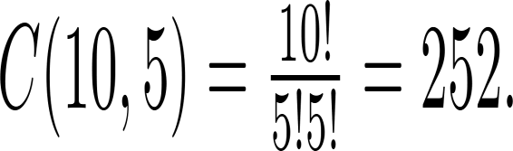
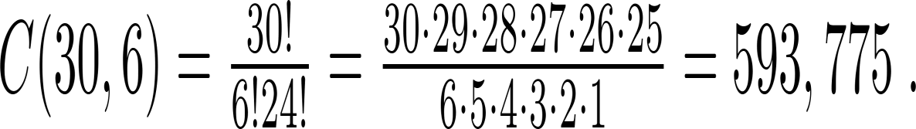
Combinations
Example: How many ways are there to select five players from a 10-member tennis team to make a trip to a match at another school.
Solution: By Theorem 2, the number of combinations is
Example: A group of 30 people have been trained as astronauts to go on the first mission to Mars. How many ways are there to select a crew of six people to go on this mission?
Solution: By Theorem 2, the number of possible crews is

